Slide 1
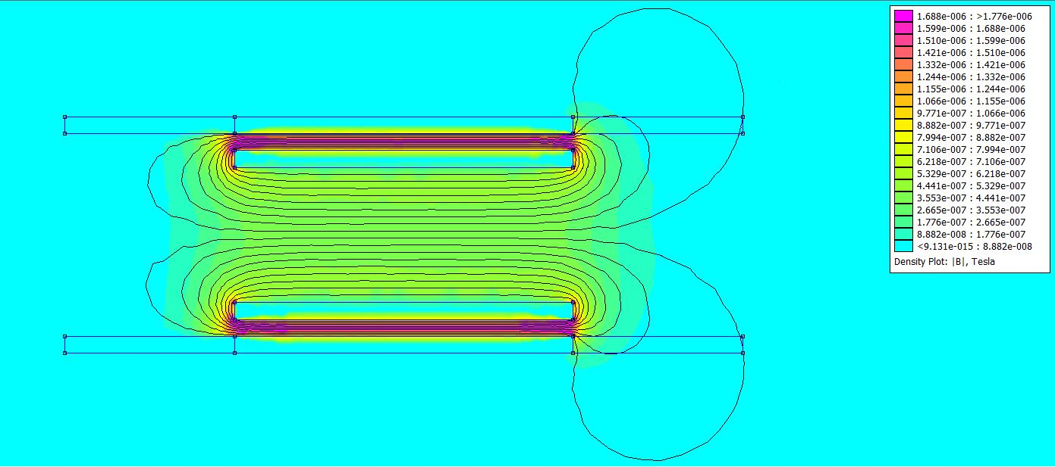
Copper Tube
Solenoid
Solenoid
Copper Tube

